Slide 1
Just Eat Cycles
Paddy Hudson (D10) Final Project

Slide 2
Background
Bike share scheme run by Serco on behalf of Transport for Edinburgh
Bikes can be accessed 24/7 via app
Redistribute, repair, develop
In 2019: 163 stations, 123 000 rides at an average of 15 minutes
Data available via OGLv3.0
No ethical/confidentiality issues

Slide 3
Approach and Challenges
Data was sourced from Just Eat Cycles and NASA POWER
Limited cleaning/wrangling required
Explore, combine, visualise, model
Closure of service
Covid
NASA POWER grid size
Lack of in-depth ride data

Slide 4
Time Spent Cycling: 48 740 Hours of Cycling in 2019
Longest ride time of 191 hours
Top/bottom day for total ride time:
2019-05-11, 610 hours, 1060 rides
2019-03-16, 14 hours, 58 rides
Top 10 busiest/quietest days
Top 10 busiest/quietest stations

Slide 5
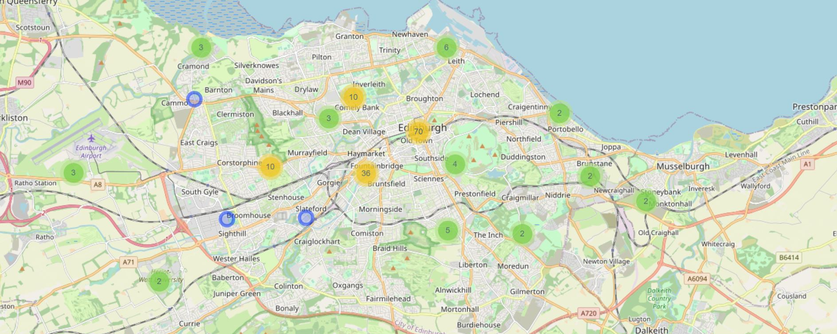
All Stations

Slide 6
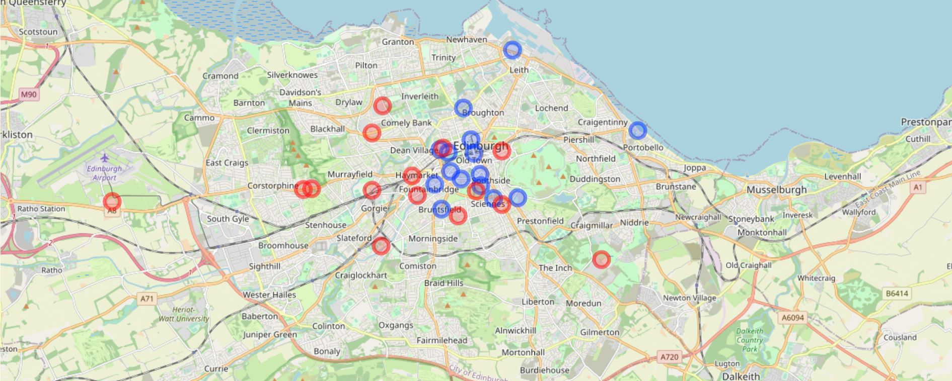
Most Popular Stations
Top/Bottom 10%

Slide 7
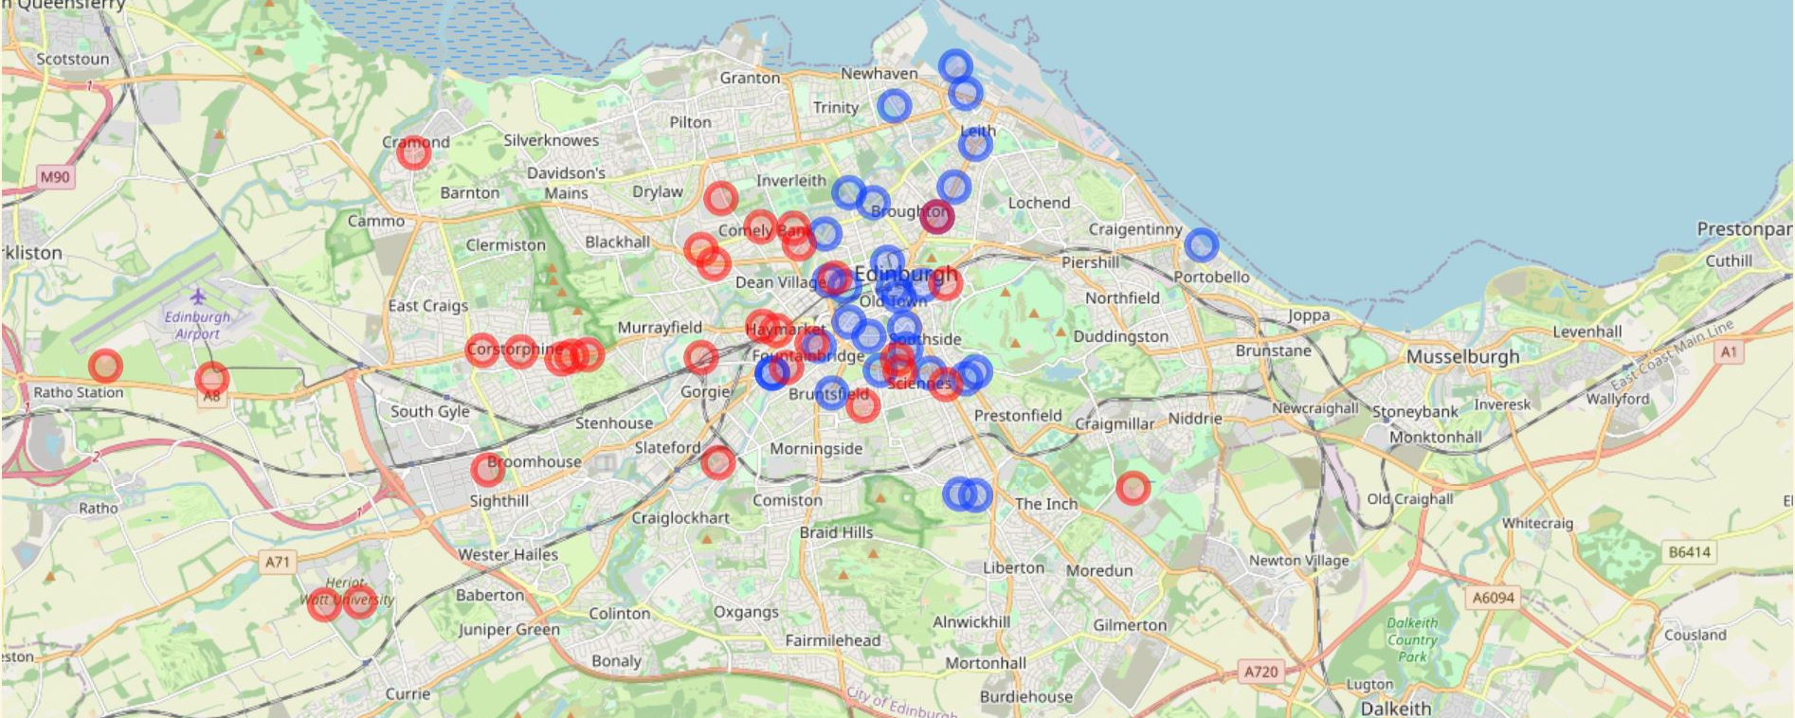
Most Popular Stations
Top/Bottom 20%

Slide 8
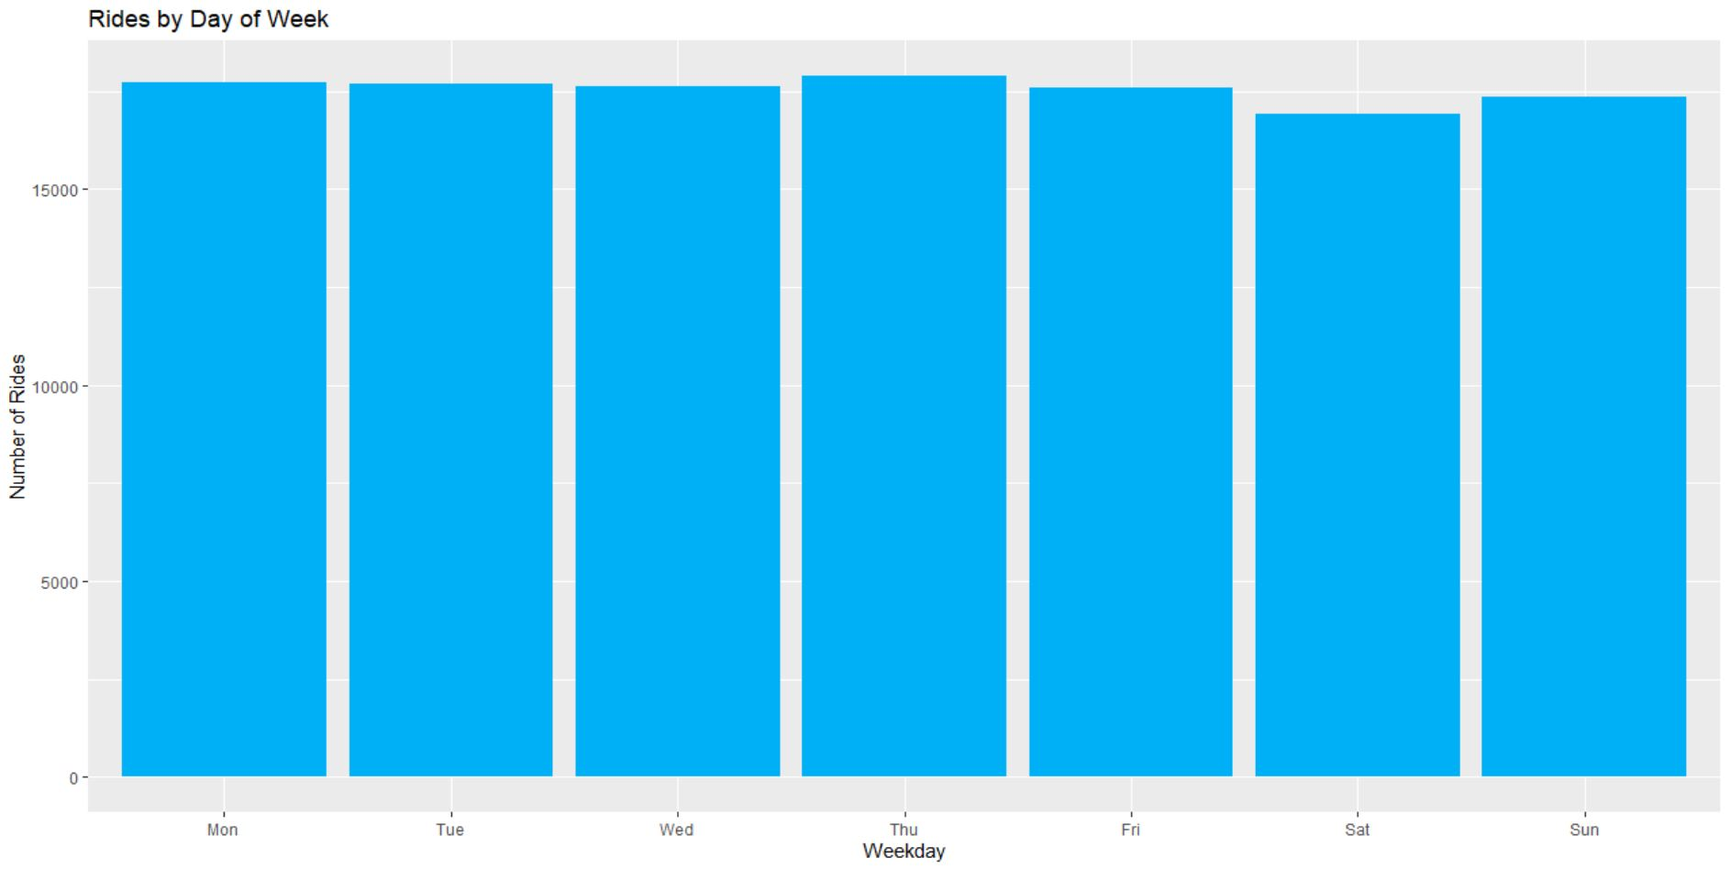

Slide 9
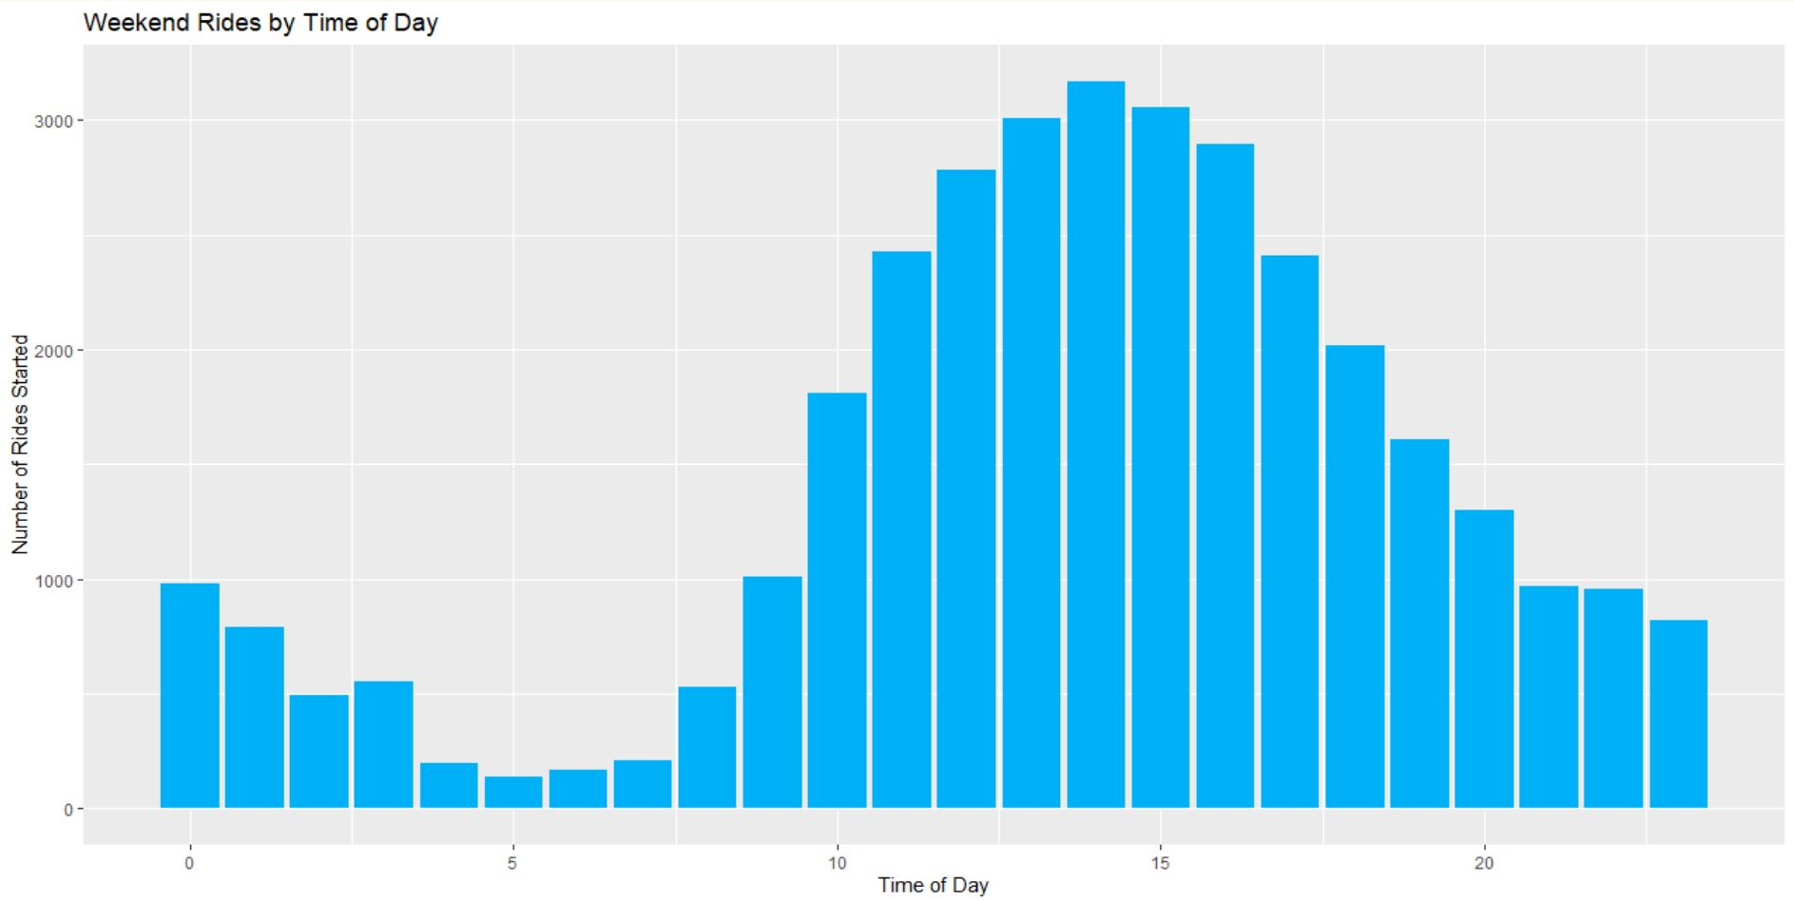

Slide 10
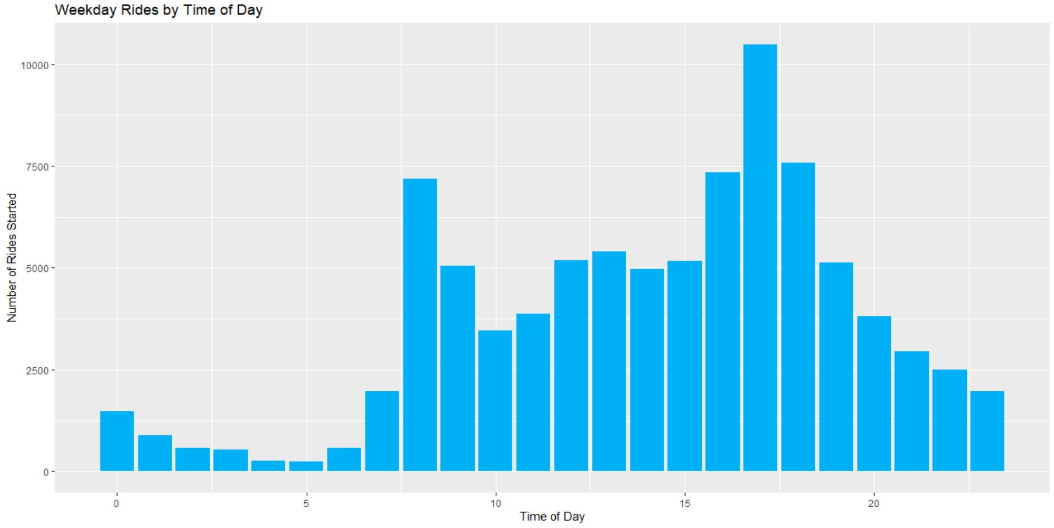

Slide 11
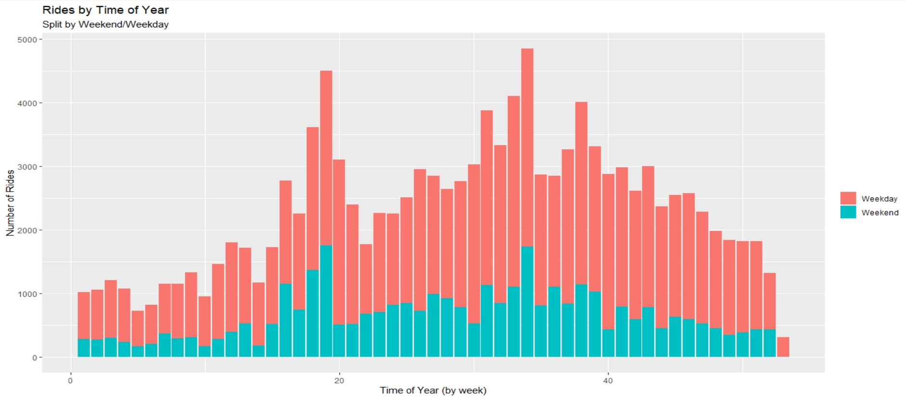

Slide 12
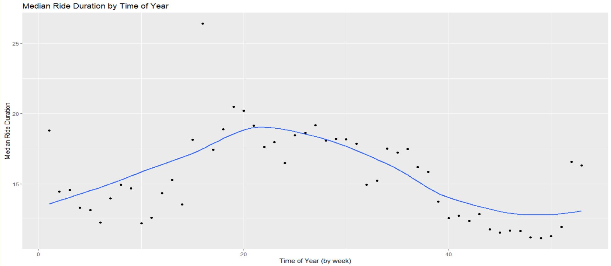

Slide 13
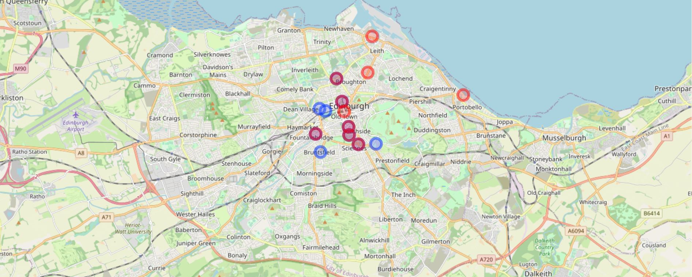
Ten Most Popular Stations for Starting/Ending a Ride
Weekday rides

Slide 14
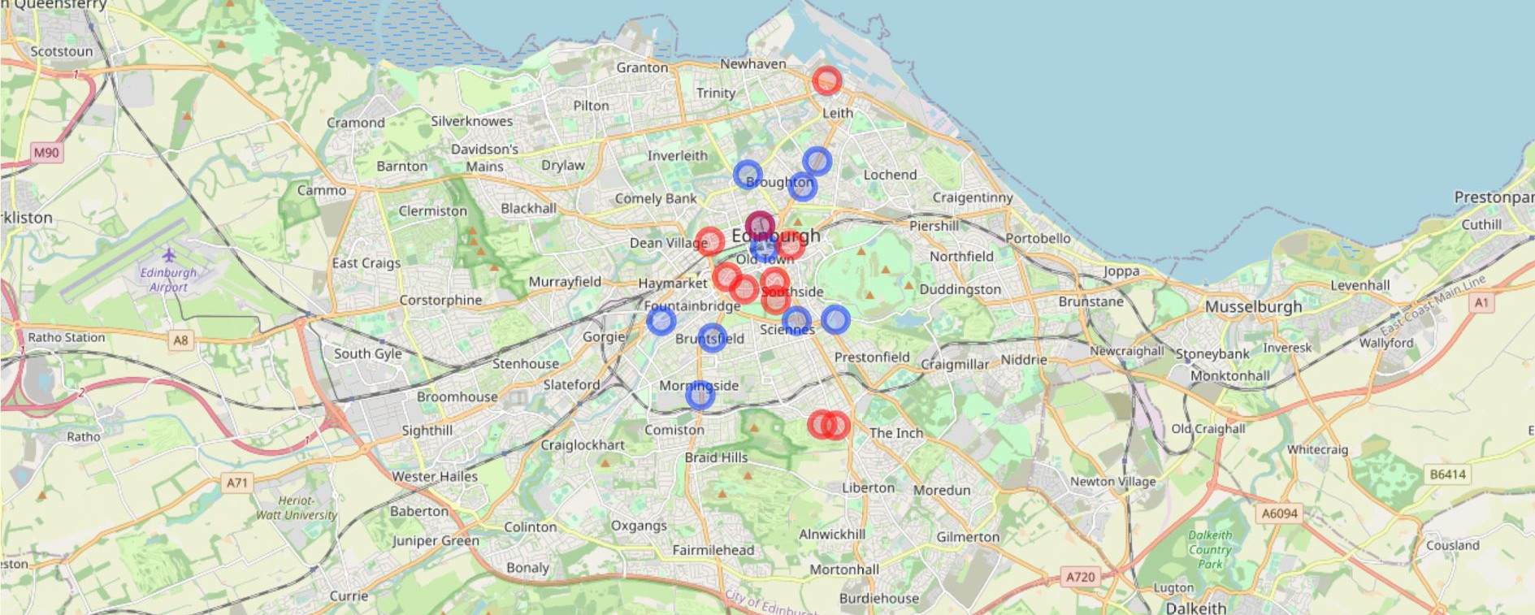
Ten Most Popular Stations for Starting/Ending a Ride
Weekday rides 0800-1000

Slide 15
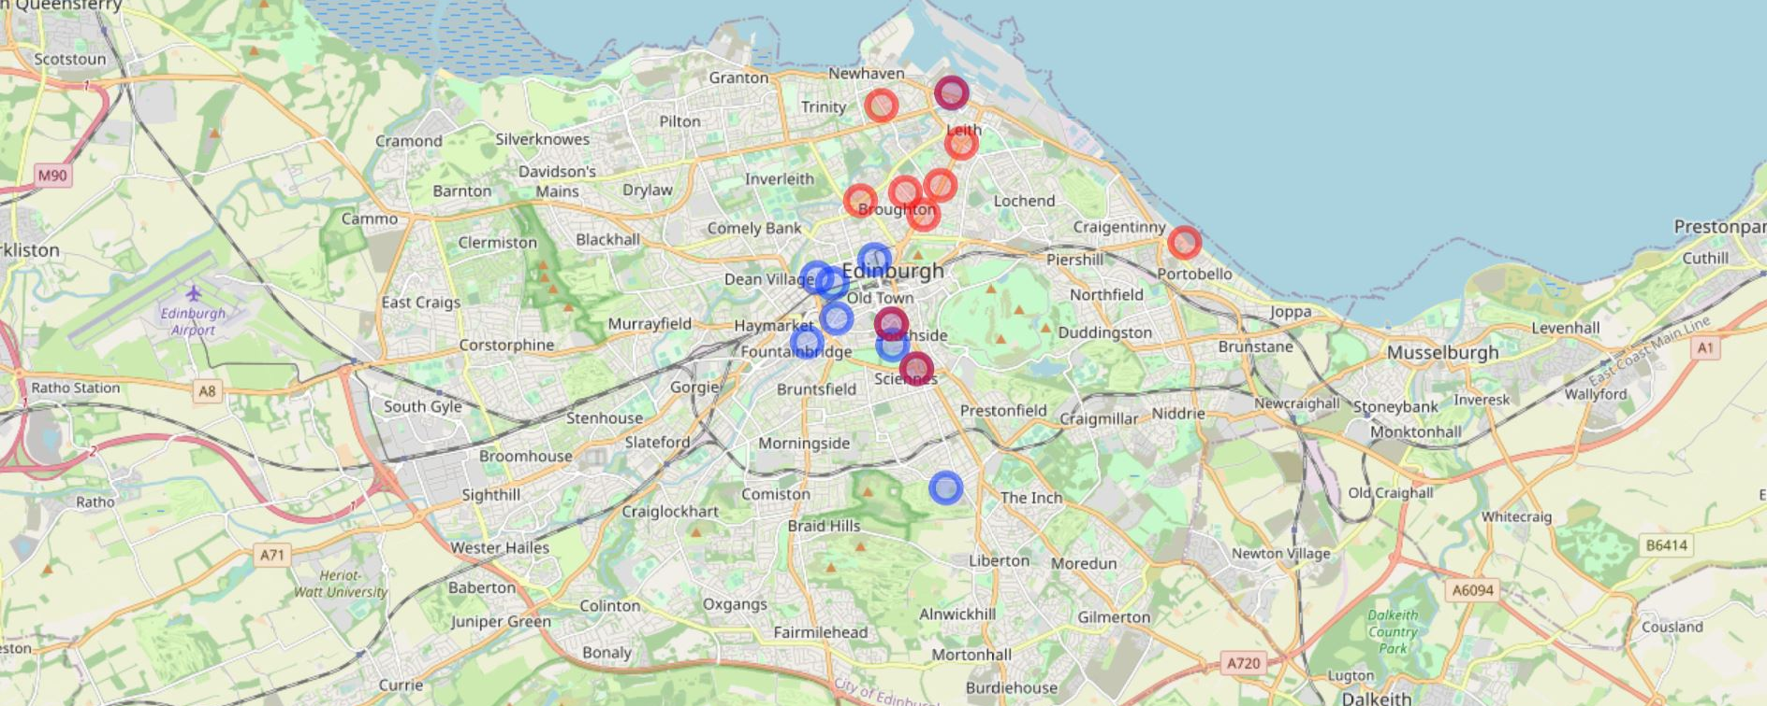
Ten Most Popular Stations for Starting/Ending a Ride
Weekday rides 1600-1900

Slide 16
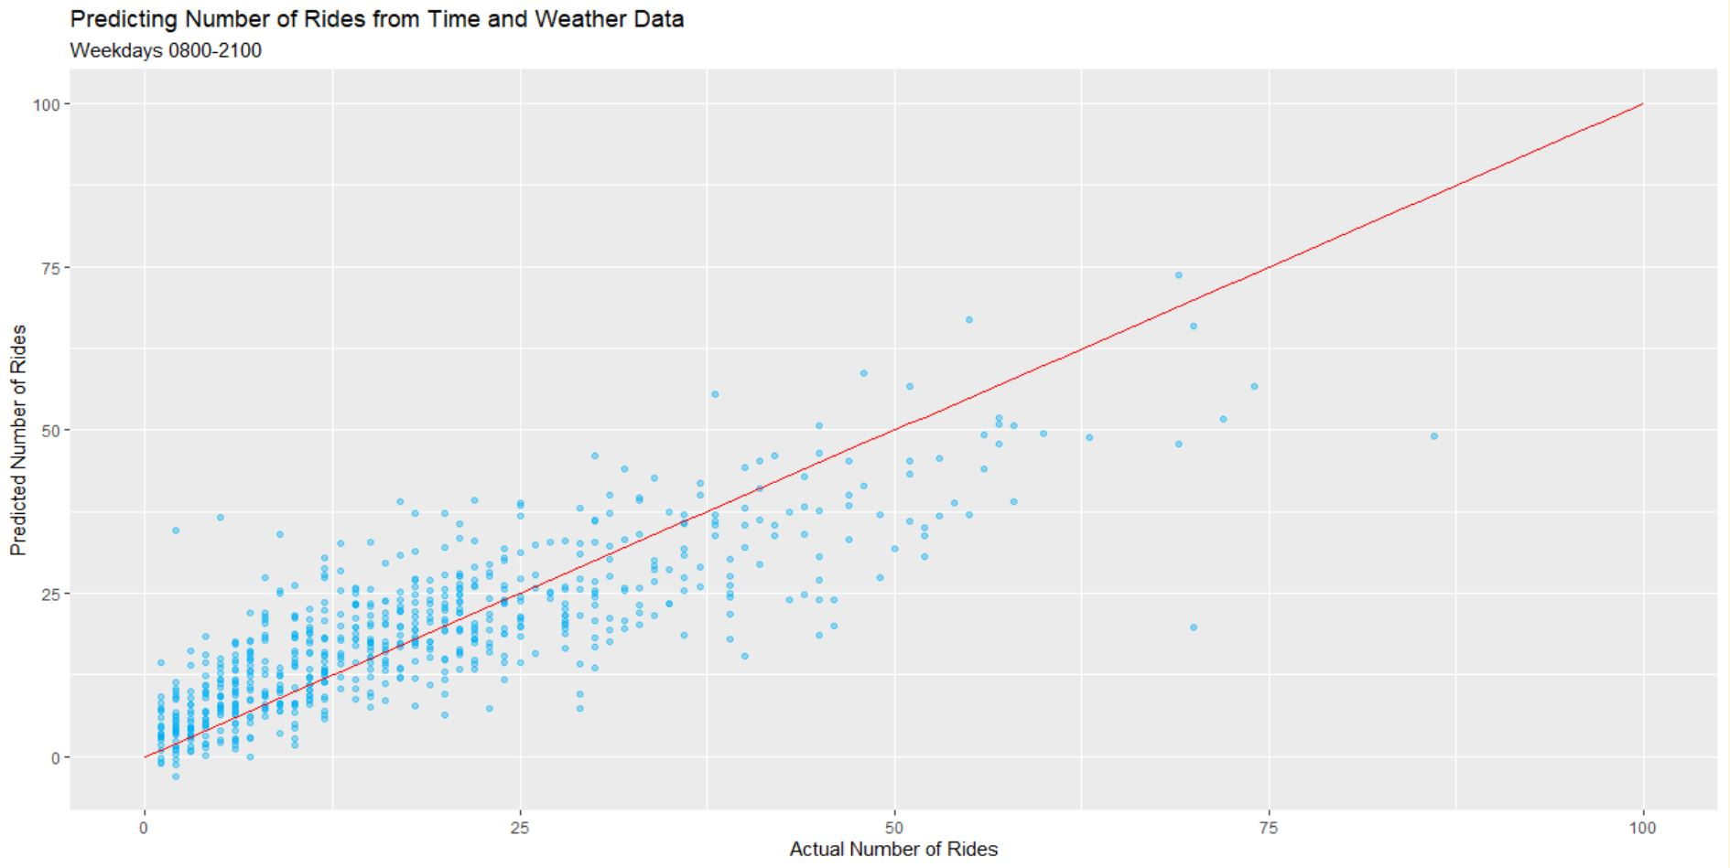
Effects of the Weather
Windspeed, Temperature, Cloud, Precipitation
Automated model building approach
Weather variables were all significant
Cloud:Temp and Wind:Precipitation relationships
Model explains 59% of variance with Hour and Temperature most relevant at 60% and 32%

Slide 17
Recommendations
Redistribute:
Scheduling for most popular stations during peak times; consider individual models
Consider closing quietest stations either permanently or seasonally
Repair:
Aim to monitor moving time of individual bikes
Develop:
First and last mile
Demographic data
Targeted advertising and promotions based on holiday periods/good weather forecast
Advertising around quieter stations

